Slide 1
Dataanalysis with R
WS 2022 / 2023
Introductory R course
Damian Wollny / Aram Safrastyan / Julia Micheel
Bioinformatics/High-Throughput Analysis
Friedrich-Schiller-University Jena
https://wollnylab.github.io/

Slide 2
Who are we?
Damian Wollny
Position: Group leader of
Acellular genomics group
Aram Safrastyan
Position: PhD student of
Acellular genomics group
Julia Micheel
Position: PhD student of
Acellular genomics group

Slide 3
Who are you?
„Scientific“ background
Any programming background?
Expectations

Slide 4
Literature
Available for free online:
https://r4ds.had.co.nz/
Not the structure of our course
Covers things we will likely not cover in the course
Hadley Wickham
Notes:
Book best used for looking up certain concepts again. Could also be read front to cover – might be confusing though because we take a different approach to teaching

Slide 5
Course philosophy: Contextual learning
Learning R while pursuing a goal
assisting students to self-regulated learners -> google is your friend
can help bring relevance and meaning to the learning
The roles of: homework, credit points, exam…
Notes:
“Goal focussed“: is the key

Slide 6
Structure of the course
3 data analysis cycles
1st cycle: „COVID-19“ dataset
2nd cycle: „Global fertilizer usage“ dataset
3rd cycle: ???
Flexibility
Notes:
“Goal focussed“: is the key

Slide 7
Why should you learn R?
Prominent for:
Manipulating data
Visualizing data
Statistical analysis
Fairly easy to learn
Free and open source
Large community (help + libraries)
Good package management (CRAN)
R vs Python discussion
Notes:
Free and open source – not just R itself but also R studio and all packages
Large community is not just important for googling but also active development of new tools
CRAN is awesome – practically never dependecy issues
R vs Python discussion – both are fine; r better for visualization/IDE; python better for large datasets / ML

Slide 8
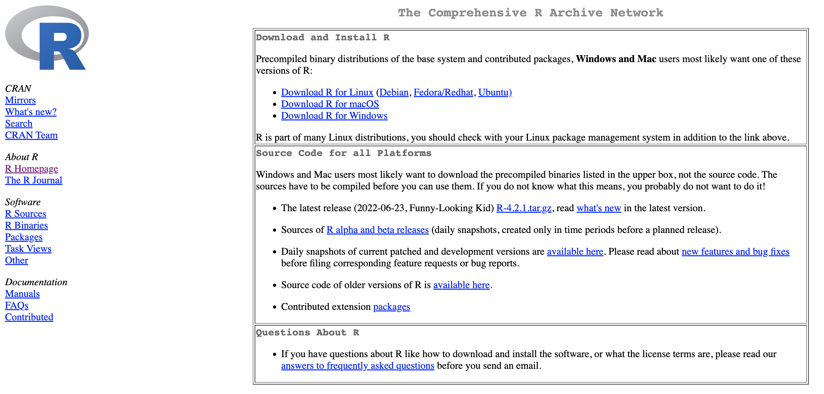
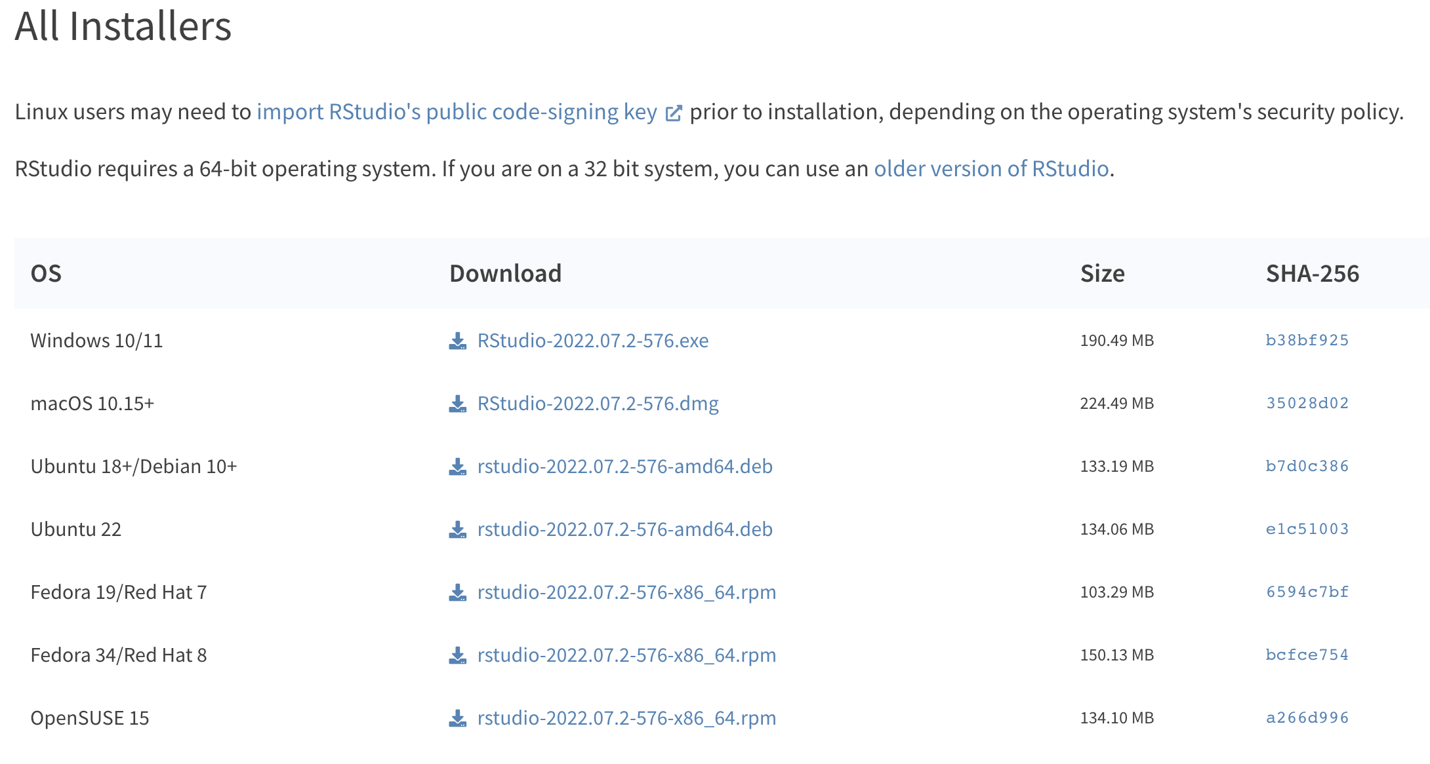
Download R / RStudio
https://cloud.r-project.org/
https://www.rstudio.com/products/rstudio/download/#download
Notes:
R is the programming language; RStudio is an integrated development environment (IDE) for R (basically the software that makes programming in R so much more convinient)

Slide 9
RStudio

